Slide 1

...visualizing classifier performance in R
Tobias Sing, Ph.D. (joint work with Oliver Sander)
Modeling & Simulation
Novartis Pharma AG
3rd BaselR meeting (Oct 13, 2010)

Slide 2
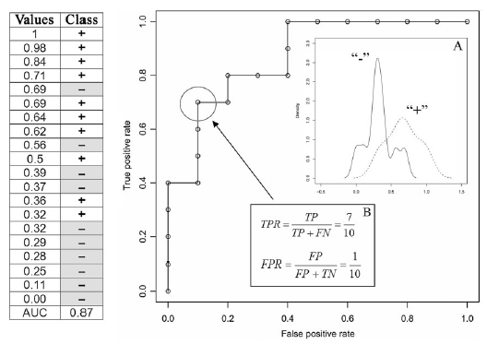
Q: When can ROCR be useful for you?
Not only in machine learning!
A: Whenever you want to evaluate a numerical score against a categorical (binary) outcome
  “Does the score separate the two classes well?”

Slide 3
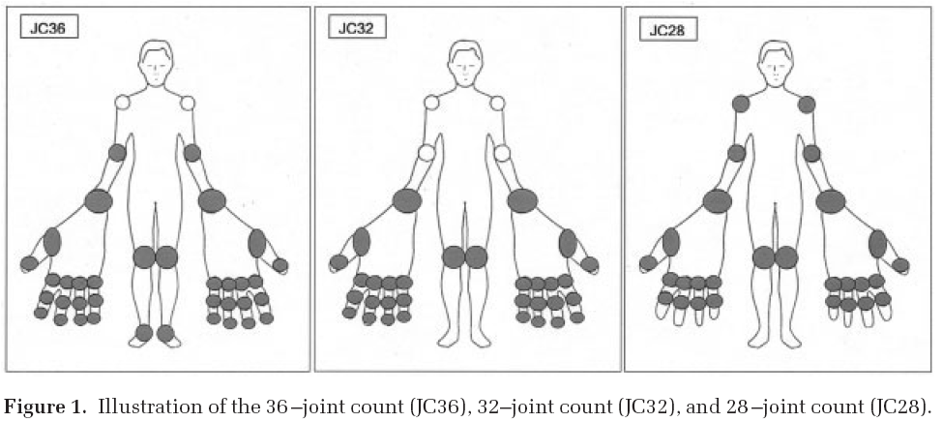
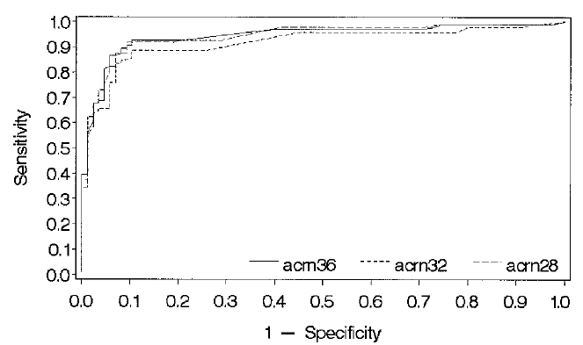
Examples
(1) Markers of disease severity in psoriatric arthritis
Numerical score: numbers of swollen and tender joints
Categorical outcome: Clinical response of ACR20 improvement (yes/no)
From: Englbrecht et al, 2010

Slide 4
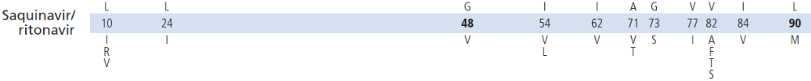
Examples
(2) HIV drug resistance
Physicians count specific mutations in the HIV genome to predict whether the virus will be resistant or susceptible to antiviral therapy.
e.g.: protease mutation list for SQV resistance from Int. AIDS Society

Slide 5
Examples
(3) Evaluating scoring output from machine learning approaches
Logistic regression
  model <- glm( Y ~ X, family=binomial, A)
  predict(model, data.frame(X=31),type='response')
  [1] 0.9930342
Decision trees
  m1 <- rpart(Class ~ . ,data=GlaucomaM)
  predict(m1,X)
  glaucoma normal
  0.9210526 0.07894737
  0.1200000 0.88000000
SVMs, Random Forests, ...

Slide 6
Scoring classifiers
Output: continuous score (instead of actual class prediction)
  Example: Saquinavir (SQV) prediction with SVMs:
  > m <- svm(sqv[,-1], sqv[,1])
  > X.new <- sqv[1:2, -1]
  > predict(m, X.new)
  1 2
  TRUE TRUE
  Use distance to the hyperplane as numeric score:
  > predict(m, X.new, decision.values=TRUE)
  attr(,"decision.values")
  TRUE/FALSE
  1 0.9995974
  2 0.9999517
If predictions are (numeric) scores, actual predictions of (categorical) classes depend on the choice of a cutoff c:
  f(x) ≥ c ➔ class „1“
  f(x) < c ➔ class „-1“
Thus, a scoring classifiers induces a family {f_{c}}_{c} of binary classifiers
Notes:
Examples: probabilities in logistic regression; distance from hyperplane in SVMs; number of trees

Slide 7
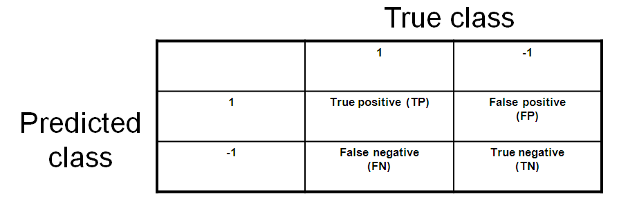
Binary classifiers (1/2)
Prediction – outcomes

Slide 8
Binary classifiers (2/2)
Some metrics of predictive performance
Accuracy: P(Ŷ = Y); estimated as (TP+TN) / (TP+FP+FN+TN)
Error rate: P(Ŷ ≠ Y); est: (FP+FN) / (TP+FP+FN+TN)
True positive rate (sensitivity, recall): P(Ŷ = 1 | Y = 1); est: TP / P
False positive rate (fallout): P(Ŷ = 1 | Y = -1); est: FP / N
True negative rate (specificity): P(Ŷ = -1 | Y = -1); est: FP / N
False negative rate (miss): P(Ŷ = -1 | Y = 1); est: FN / P
Precision (pos. predictive value): P(Y= 1 | Ŷ = 1); est: TP / (TP+FP)
True class
 | 1 | -1
1 | True positive (TP) | False positive (FP)
-1 | False negative (FN) | True negative (TN)
Predicted
class

Slide 9
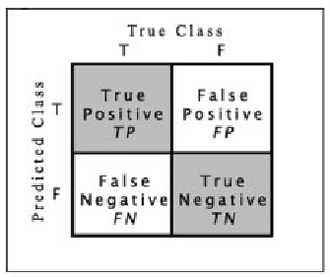
Performance curves for visualizing trade-offs
Often the choice of a cutoff c involves trading off two competing performance measures, e.g. TPR: P(Ŷ = 1 | Y = 1) vs. FPR: P(Ŷ = 1 | Y = -1)
Performance curves (ROC, sensitivity-specificity, precision-recall, lift charts, ...) are used to visualize this trade-off

Slide 10
Classifier evaluation with ROCR
Only three commands
  pred <- prediction( scores, labels )
  (pred: S4 object of class prediction)
  perf <- performance( pred, measure.Y, measure.X)
  (pred: S4 object of class performance)
  plot( perf )
Input format
  Single run:
  vectors (scores: numeric; labels: anything)
  Multiple runs (cross-validation, bootstrapping, …):
  matrices or lists
Output format
Formal class 'performance' [package "ROCR"] with 6 slots|
..@ x.name : chr "Cutoff"
..@ y.name : chr "Accuracy"
..@ alpha.name : chr "none"
..@ x.values :List of 10
..@ y.values :List of 10
..@ alpha.values: list()
Notes:
~30 performance measures

Slide 11
Classifier evaluation with ROCR: An example
Example: Cross-validation of saquinavir resistance prediction with SVMs
> library(ROCR)
Only take first training/test run for now:
> pred <- prediction(as.numeric(predictions[[1]]), true.classes[[1]])
> perf <- performance(pred, 'acc')
> perf@y.values
[[1]]
[1] 0.6024096 0.9397590 0.3975904
You will understand in a minute why there are three accuracies (the one in the middle is relevant here)
Works exactly the same with cross-validation data (give predictions and true classes for the different folds as a list or matrix) – we have already prepared the data correctly:
> str(predictions)
List of 10
$ : Factor w/ 2 levels "FALSE","TRUE": 2 1 2 2 1 1 2 2 1 1 ...
$ : Factor w/ 2 levels "FALSE","TRUE": 2 2 2 2 1 1 1 1 1 2 ...
> pred <- prediction(lapply(predictions, as.numeric), true.classes)
> perf <- performance(pred, 'acc')
> perf@y.values
[[1]]
[1] 0.6024096 0.9397590 0.3975904
[[2]]
[1] 0.5903614 0.9638554 0.4096386

Slide 12
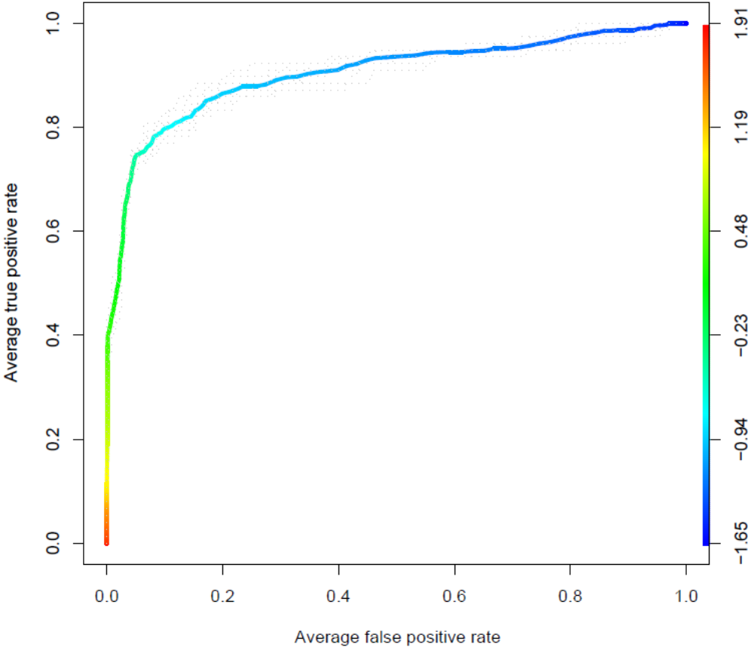
Examples (1/8): ROC curves
pred <- prediction(scores, labels)
perf <- performance(pred, "tpr", "fpr")
plot(perf, colorize=T)

Slide 13
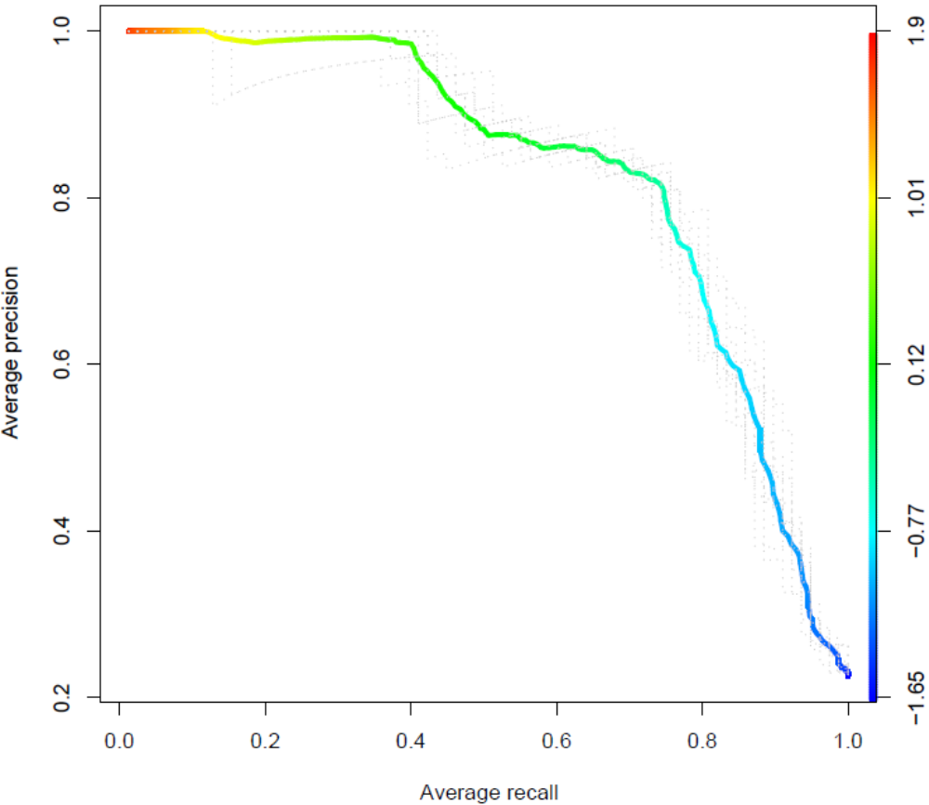
Examples (2/8): Precision/recall curves
pred <- prediction(scores, labels)
perf <- performance(pred, "prec", "rec")
plot(perf, colorize=T)

Slide 14
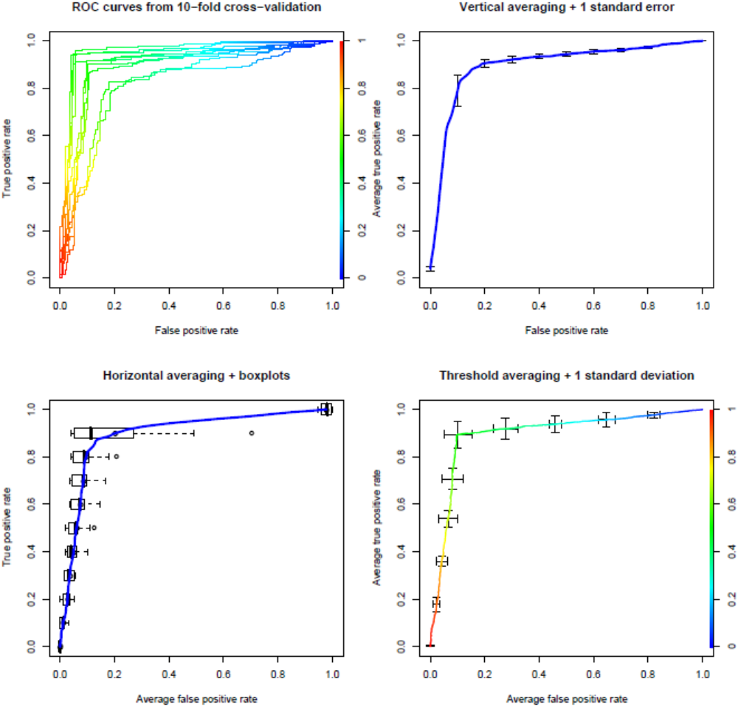
Examples (3/8): Averaging across multiple runs
pred <- prediction(scores, labels)
perf <- performance(pred, "tpr", "fpr")
plot(perf, avg='threshold', spread.estimate='stddev', colorize=T)

Slide 15
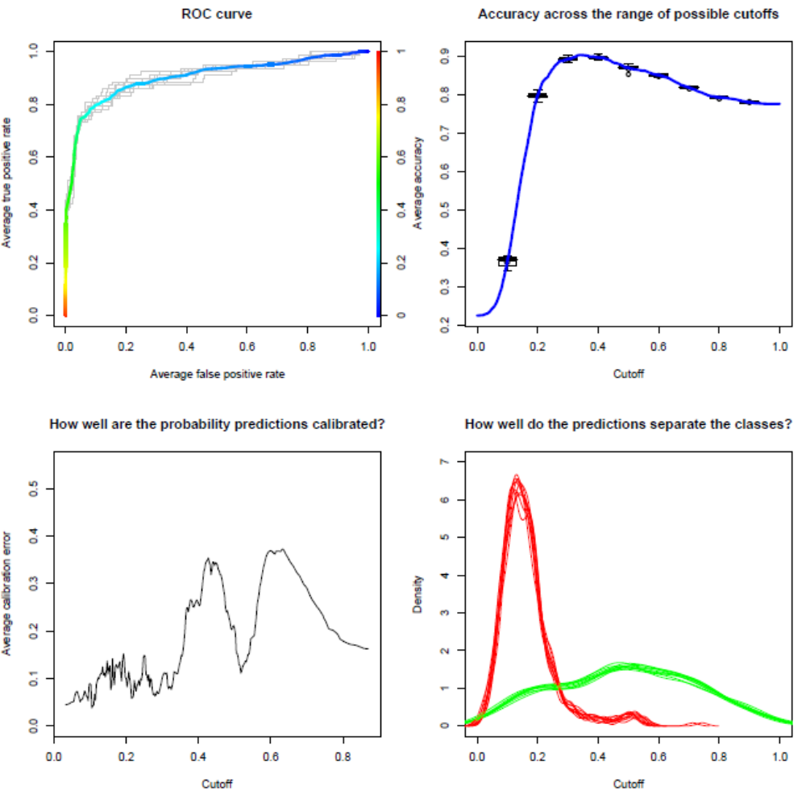
Examples (4/8): Performance vs. cutoff
perf <- performance(pred, "cal",
window.size=50)
plot(perf)
perf <- performance(pred, "acc")
plot(perf, avg= "vertical",
spread.estimate="boxplot",
show.spread.at= seq(0.1, 0.9, by=0.1))

Slide 16
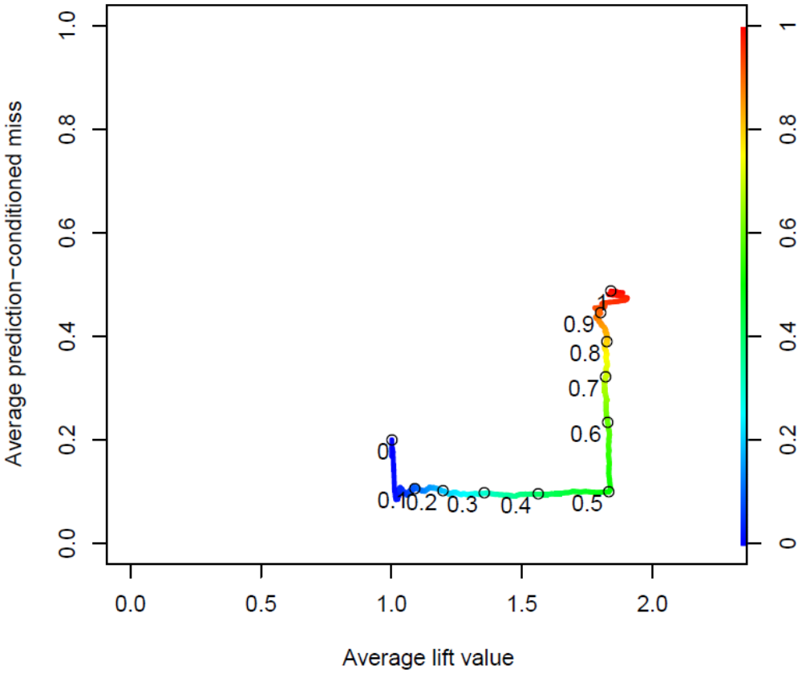
Examples (5/8): Cutoff labeling
pred <- prediction(scores, labels)
perf <- performance(pred,"pcmiss","lift")
plot(perf, colorize=T, print.cutoffs.at=seq(0,1,by=0.1), text.adj=c(1.2,1.2), avg="threshold", lwd=3)

Slide 17
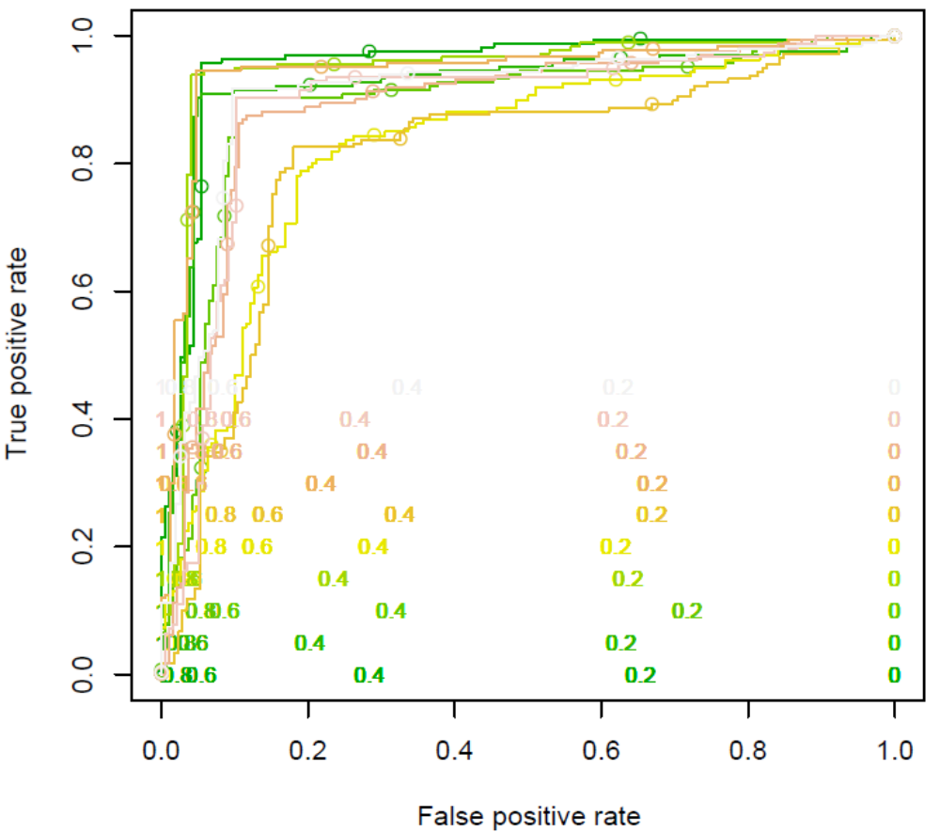
Examples (6/8): Cutoff labeling – multiple runs
plot(perf,
print.cutoffs.at=seq(0,1,by=0.2),
text.cex=0.8,
text.y=lapply(as.list(seq(0,0.5,by=0.05)),
function(x) {
rep(x,length(perf@x.values[[1]]))}),
col= as.list(terrain.colors(10)),
text.col= as.list(terrain.colors(10)),
points.col= as.list(terrain.colors(10)))

Slide 18
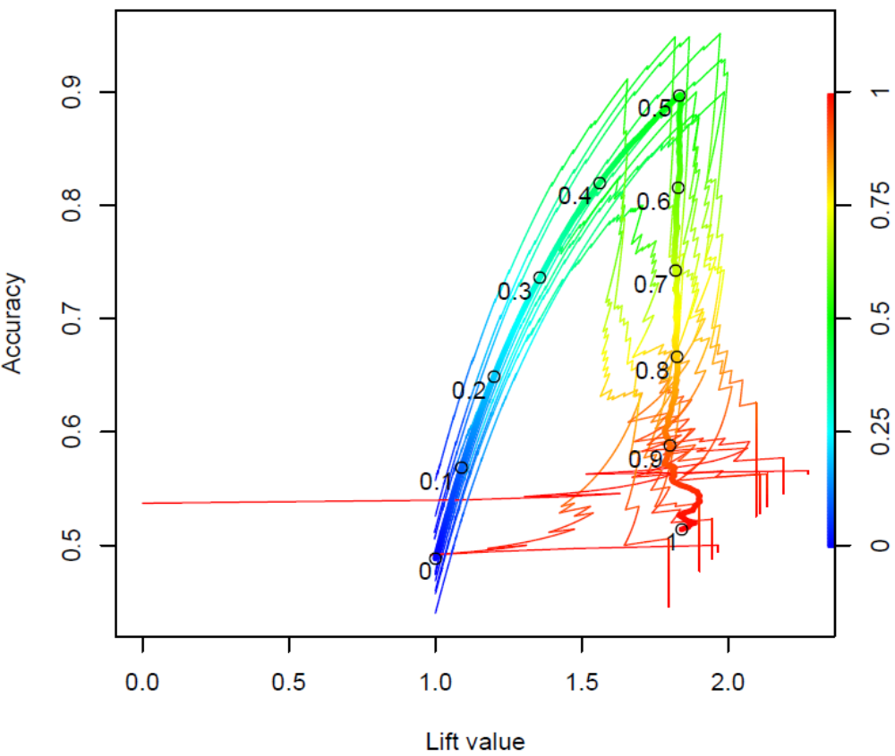
Examples (7/8): More complex trade-offs...
perf <- performance(pred,"acc","lift")
plot(perf, colorize=T)
plot(perf, colorize=T,
print.cutoffs.at=seq(0,1,by=0.1),
add=T, text.adj=c(1.2, 1.2),
avg="threshold", lwd=3)

Slide 19
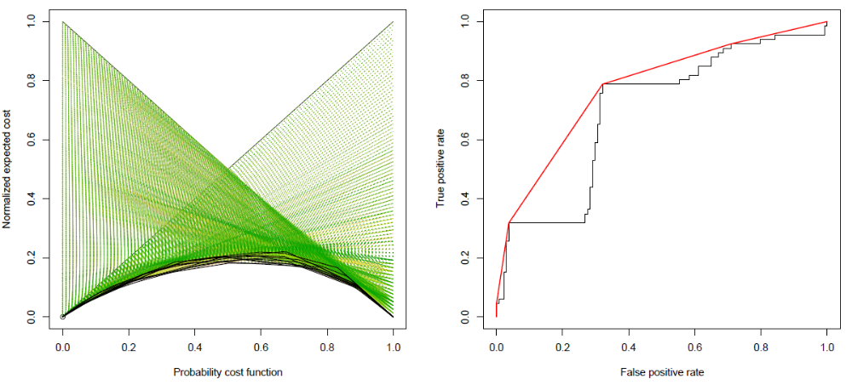
Examples (8/8): Some other examples
perf<-performance(
pred, 'ecost')
plot(perf)
perf<-performance(
pred, 'rch')
plot(perf)

Slide 20
Extending ROCR: An example
Extend environments
  assign("auc", "Area under the ROC curve",
  envir = long.unit.names)
  assign("auc", ".performance.auc",
  envir = function.names)
  assign("auc", "fpr.stop", envir=optional.arguments)
  assign("auc:fpr.stop", 1, envir=default.values)
Implement performance measure (predefined signature)
  .performance.auc <-
  function (predictions, labels, cutoffs, fp, tp, fn,
  tn, n.pos, n.neg, n.pos.pred, n.neg.pred, fpr.stop)
  {
  }

Slide 21

Now....
...get ROCR from CRAN! ☺
demo(ROCR) [cycle through examples by hitting <Enter>, examine R code that is shown]
Help pages:
  help(package=ROCR)
  ?prediction
  ?performance
  ?plot.performance
  ?'prediction-class'
  ?'performance-class‘
Please cite the ROCR paper!

